Slide 1
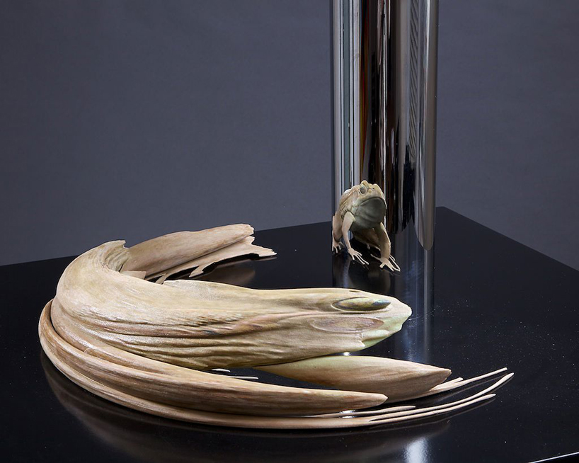
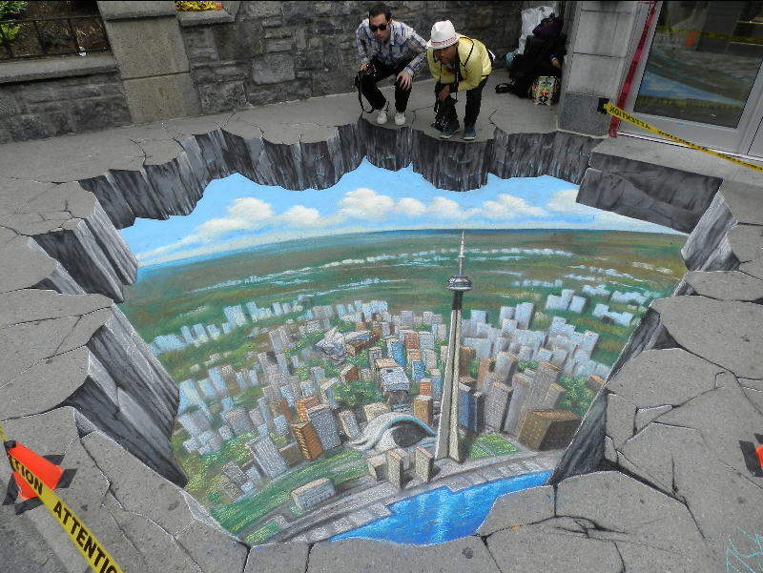
Anamorphic projections
Van Mai Nguyen Thi
Joint Senior Project: Mathematics & Computer Science
Advisers: Keith O’Hara and Jim Belk

Slide 2
An anamorphosis is an image that is intentionally distorted so that the original image can be seen only when looked at from a certain perspective, or using a special device, for example a mirror.

Slide 3
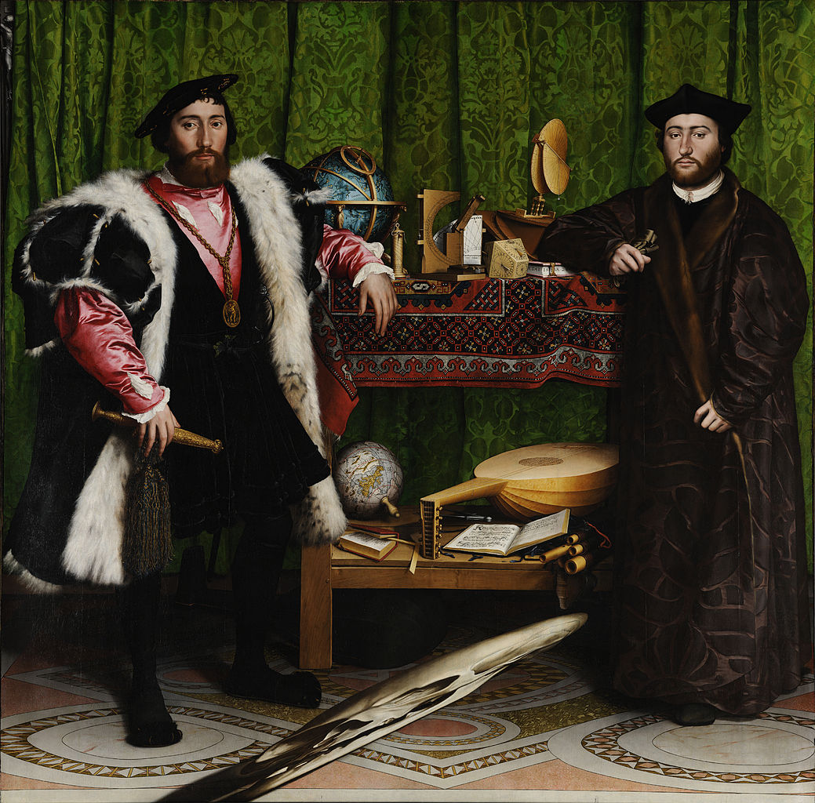
Examples
The Ambassadors
by Hans Holbein, 1533

Slide 4
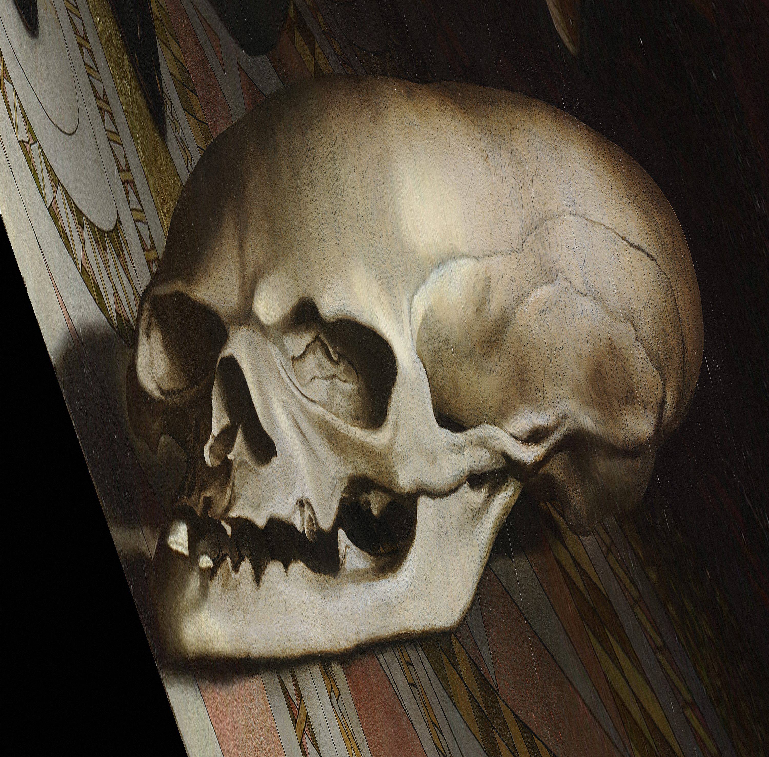
Examples
The Ambassadors
by Hans Holbein, 1533

Slide 5

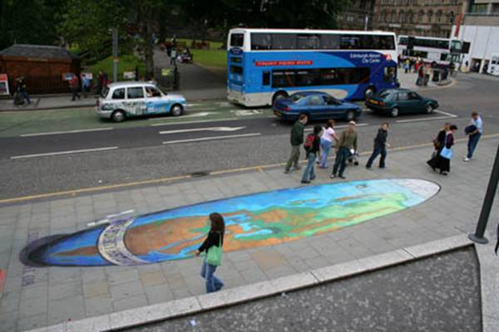
Examples
Make Poverty History by Julian Beever

Slide 6
Types of anamorphosis
Anamorphosis
Planar
Multi-planar
Non-planar
Mirror
Perspective
Cylindrical
Conical

Slide 7
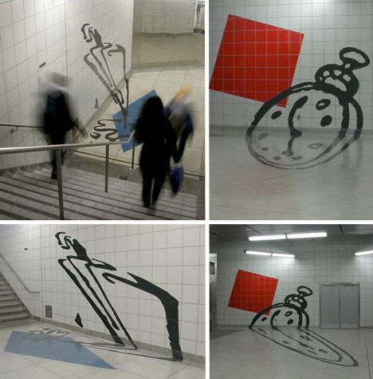
Multi-planar anamorphosis
Anamorphic art in the Toronto subway
by Panya Clark Espinal

Slide 8
Homography mapping
Sukthankar, R., et al. Smarter Presentations: Exploiting Homography in Camera-Projector Systems. International Conference on Computer Vision, 2001.

Slide 9
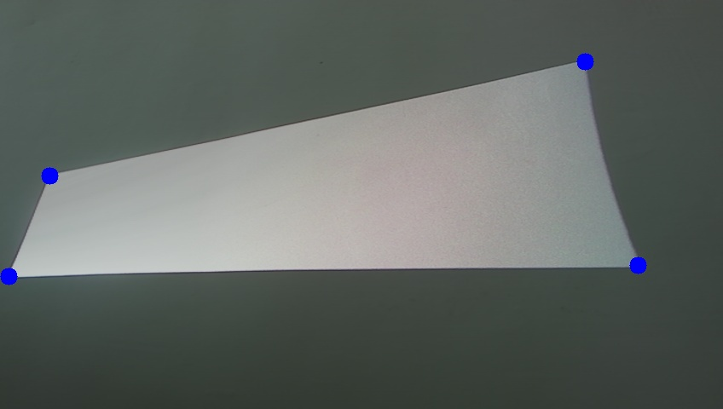
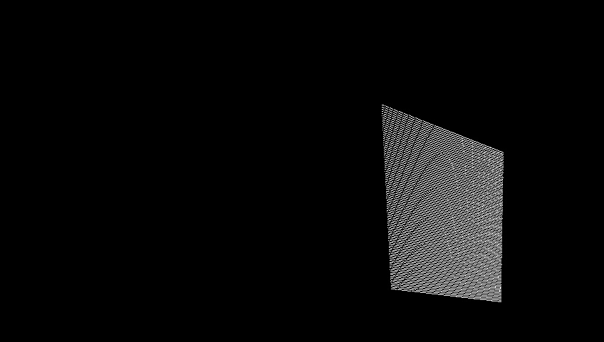
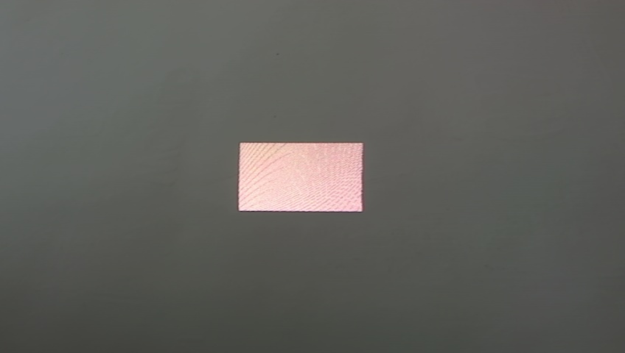
Estimating plane anamorphosis
Project a pattern
Find at least 4 common points
Estimate H using the least squares method
Use H⁻¹ to pre-warp the original image

Slide 10
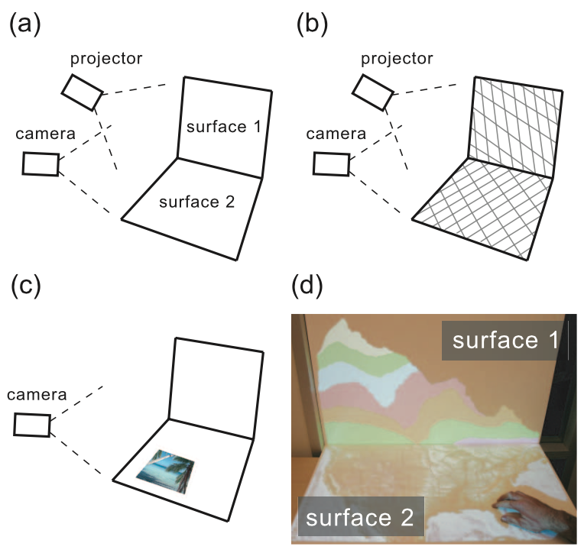
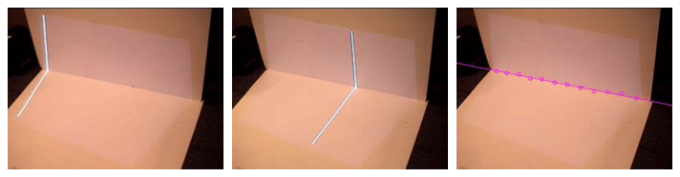
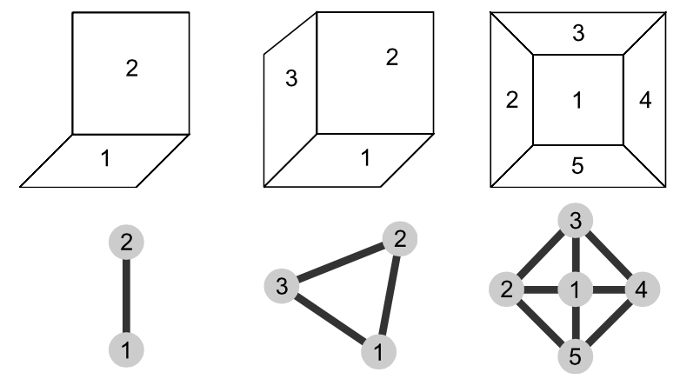
Detecting multi-planar surfaces
Ashdown M., et. al. A Flexible Projector-Camera System for Multi-Planar Displays, Proceedings of IEEE Computer Society Conference on CVPR, volume II, 2004

Slide 11
What I plan to do...
Automatically generate anamorphic images that can be projected on more complex surfaces
Given multiple viewers, generate an anamorphic image that is optimal for all viewers.
Explore other types of anamorphosis

Slide 12
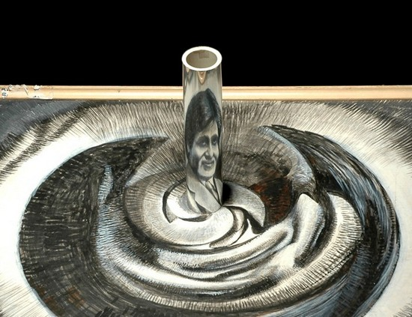
Cylindrical mirror anamorphosis
A drawing
by Awtar Singh Virdi

